Slide 1

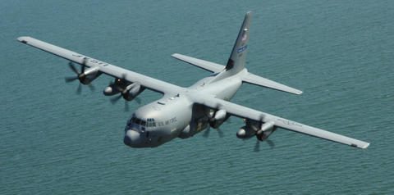
Outflow layer structure in Hurricanes Leslie and Nadine
revealed by dropsondes deployed from NASA Global Hawk
UAV aircraft during the 2012 Hurricane and
Severe Storms Sentinel (HS3) campaign
Peter G. Black¹,
Jon Moskaitis², James Doyle², Chris Velden³ and Scott Braun⁴
(With special thanks to Michael Black, NOAA/AOML/HRD for sonde processing)
¹Naval Research Laboratory and SAIC, Inc., Monterey, CA
²Naval Research Laboratory, Monterey, CA
³U. Wisconsin/ Cooperative Institute for Meteorological Satellite Studies, Madison, WI
⁴NASA Goddard Space Flight Center, Greenbelt, MD

Slide 2
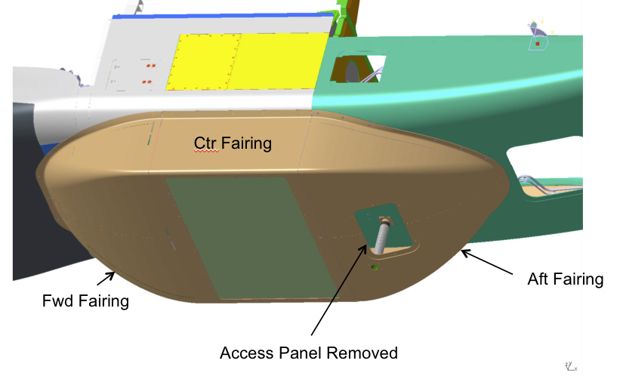
NASA Venture-class Mission
HS3: Hurricane and Severe Storm Sentinel
Science goals include better understanding of outflow structure changes related to intensity changes
One Global Hawk was used in 2012, two to be used in 2012-13: one concentrating on TC inner-core structures, and the other on the large-scale environment
Ensemble of instruments include Cloud Physics Lidar, NCAR and Navy dropsonde systems, HIWRAP profiling Doppler radar, HIRAD surface winds and HAMSR
HS3 flights during 2013-14 will be in the North Atlantic, while follow-on EV-3 flights would be in WPAC during 2015-17.

Slide 3
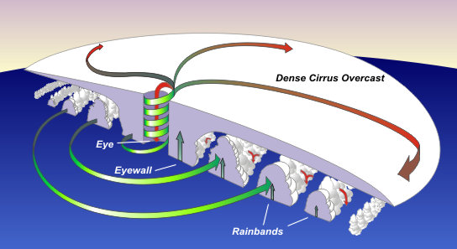




Strategy: 1) WC-130J to monitor the TC intensity and boundary layer structure
2) Global Hawks to observe the outflow and environment
Upper-Level Outflow
Upper-Level Outflow
Radar
CPL
HIRAD
HIWRAP
GPS
Dropsonde
SFMR
GPS
Sonde
Low-Level Inflow
Secondary Circulation: IN, UP & OUT
Background schematic courtesy of NASA

Slide 4
Observational Strategy
Global Hawk:
AV-1 remote sensors
  HIRAD
  HIWRAP
  HAMSR
Navy Dropsondes?
AV-6 Remote Sensors
  CPL
  H-HIS
  TwiLite?
NCAR Dropsondes
15
Outflow
10
Height (km)
Air Force WC-130J:
SFMR: Surface winds / intensity
Radar: Precipitation structure
GPS Dropsondes: Vertical Structure-
wind, temperature, humidity
5
Radar
SFMR
0
100
300
600
radius (nm)
Strategy: WC-130J to monitor the TC intensity and structure
Global Hawks to observe the outflow and environment
Notes:
These are average position and intensity errors from the National Hurricane Center from 1990-present.
Left panel: Track errors from the NHC official forecasts.
Track errors have steadily declined in the past twenty years as global NWP models have improved in their ability to predict the large-scale environment
(better resolution, physics, and data assimilation).
Right panel: Intensity forecast errors.
Note that there has been no improvement in TC intensity prediction skill over past twenty years.
Intensity is dependent both on environmental aspects as well as inner-core processes which remain largely unknown.

Slide 5
Key Science Issues
Understand the coupling between all the branches of the secondary circulation (and the relationship of this coupling to intensity changes)
  Upper-level outflow changes lead to increased convection and intensification.
    Active Outflow
    Interaction of environment with TC
  Upper-level outflow changes result from increased convection
    Passive Outflow
    Interaction of TC with environment
  Dependencies on boundary layer characteristics
  Secondary eyewall cycles
Linkages between changes in the secondary circulation and their influence on the primary circulation (TC intensity changes)
  How do changes in the outflow impact changes in TC intensity?
  What are the relative roles of the TC vortex and the environment?
Evolution of outflow in relation to the environment
  Outflow Morphology and TC dynamics
  Interaction between the outflow and the upper level environment (phasing, depth and strength of the outflow)
  Evolution of outflow channels and associated rapid intensification or weakening
Notes:
Basic theory sets up the three key science issues that will be the focus of this DRI:
1. The relationship between the TC outflow and the inner-core convection; how these are coupled and their relationship to intensity
two competing hypotheses here: Active outflow vs. Passive outflow
2. Upper-level outflow changes result from increased convection (Passive Outflow) (hard to imagine that this is the PRIMARY cause of RAPID intensification)

Slide 6
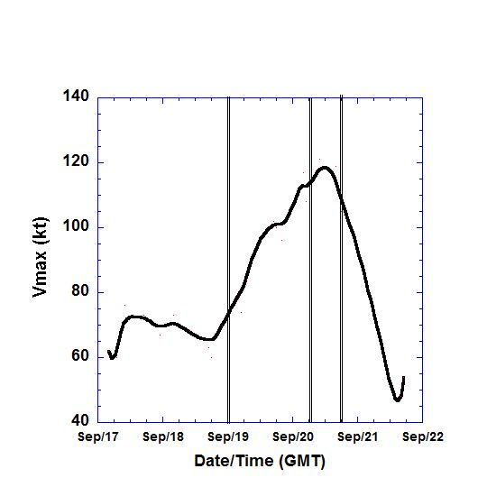
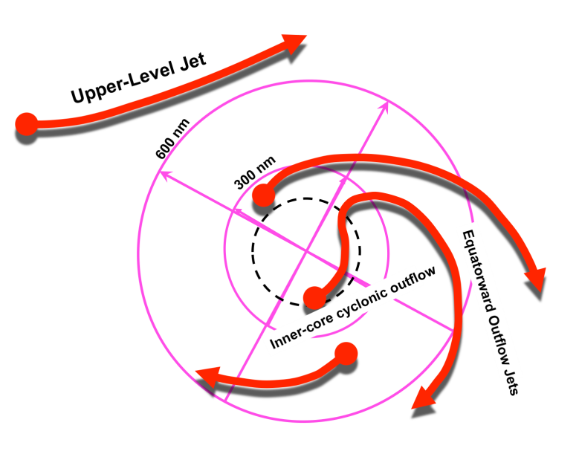
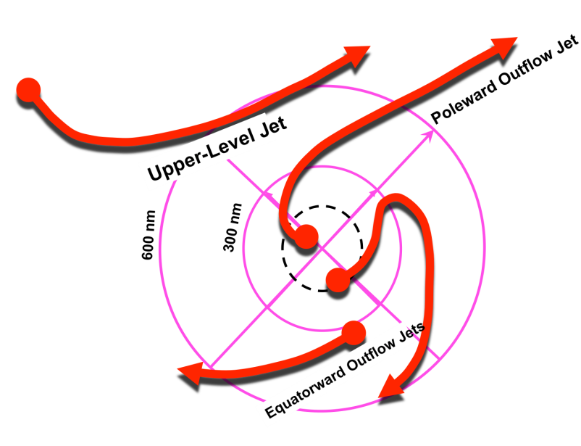
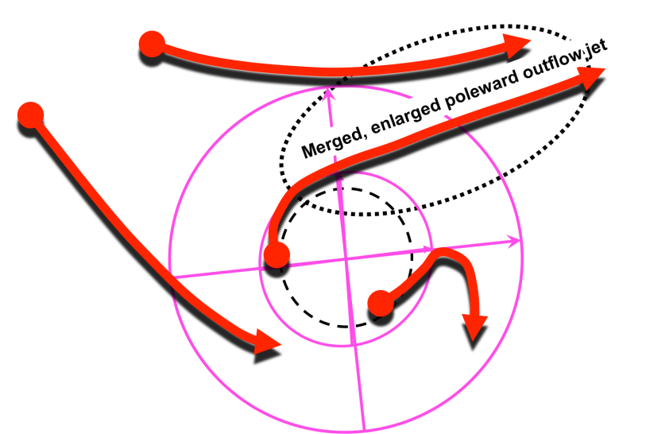
Lifecycle Hypothesis
Analysis of the Roke Outflow Channel Morphology and comparison to 6 other cases studies:
  WPAC: Roke and Songda
  ATL: Earl and Irene
  GOM: Charlie, Katrina, and Opal
led to the following hypothesis relating the morphology of the TC outflow to TC intensity:
HYPOTHESIS: There is a characteristic evolution of the outflow as the storm interacts with the environment that corresponds to changes in intensity and structure.

Slide 7
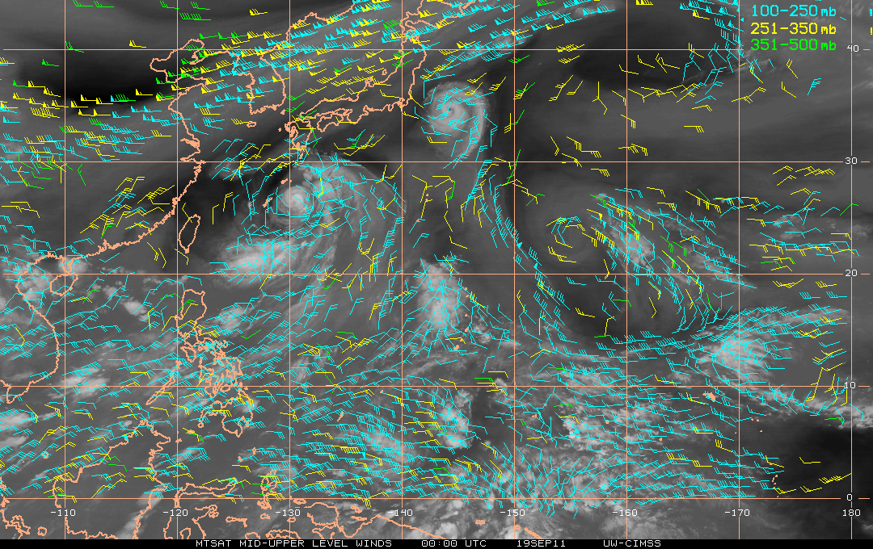
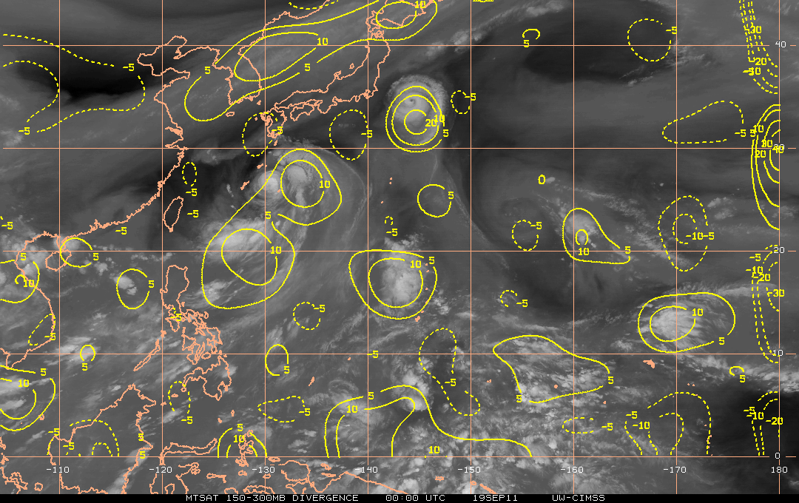
Upper-Level
Jet
Outflow & Intensification
Typhoon Roke
Pre-Rapid Intensification
00 UTC 19 Sep 2011
Intensity = 65 kt
Roke
150-300 mb Divergence
Outflow
Winds: 100-250 mb, 251-350 mb, 351-500 mb
Roke
Outflow directed equatorward
No interaction between outflow and approaching upper-level jet
Weak upper-level divergence
Weak typhoon

Slide 8
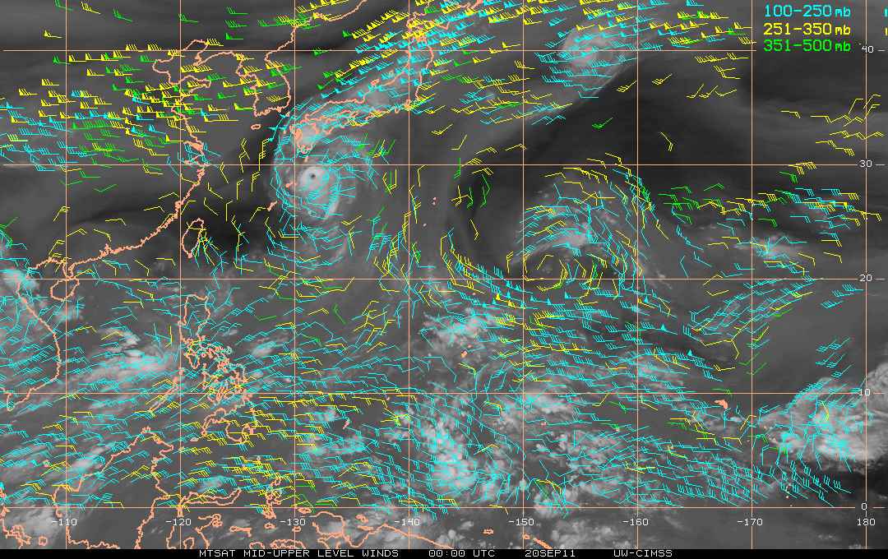
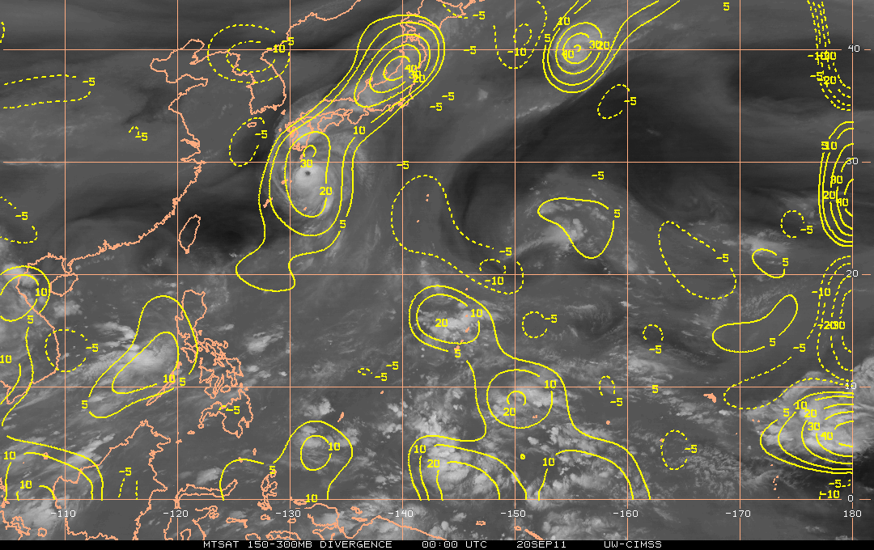
Upper-Level
Jet
Outflow & Intensification
Typhoon Roke
Rapid Intensification
00 UTC 20 Sep 2011 (+24h)
Outflow
Intensity = 115 kt
Roke
150-300 mb Divergence
Roke
Outflow shifts poleward
Outflow couples with mid-latitude jet
Upper-level divergence doubles
Roke undergoes Rapid Intensification, increases intensity by 50 kts in 24 hours

Slide 9
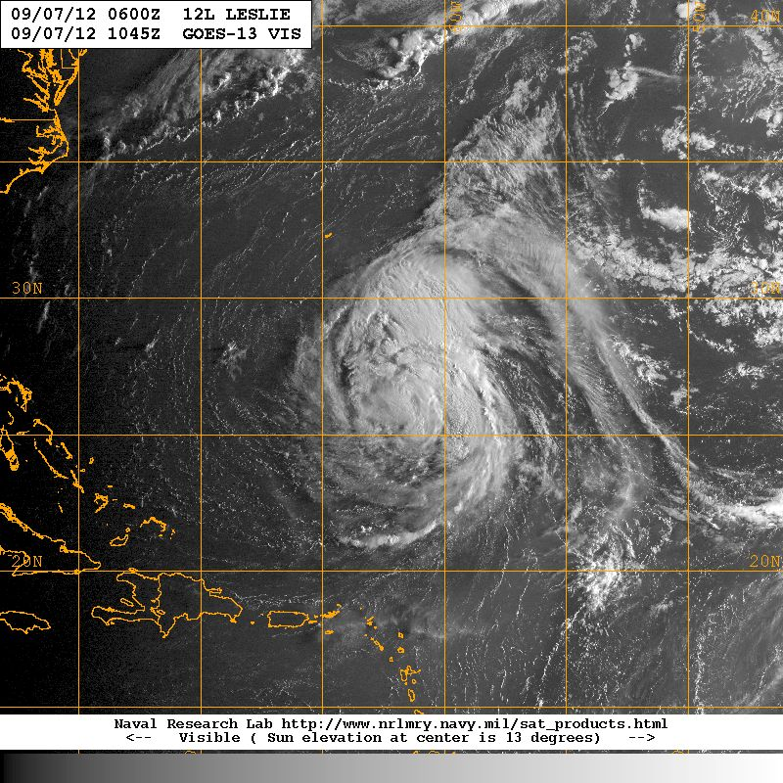
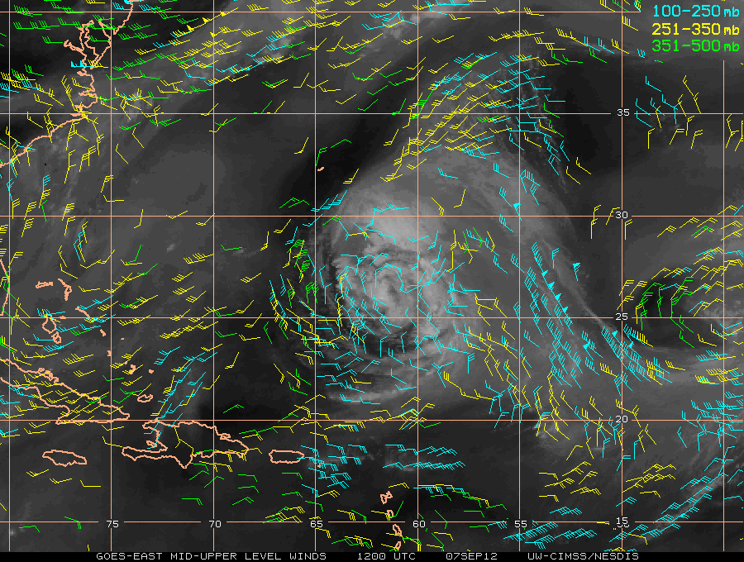
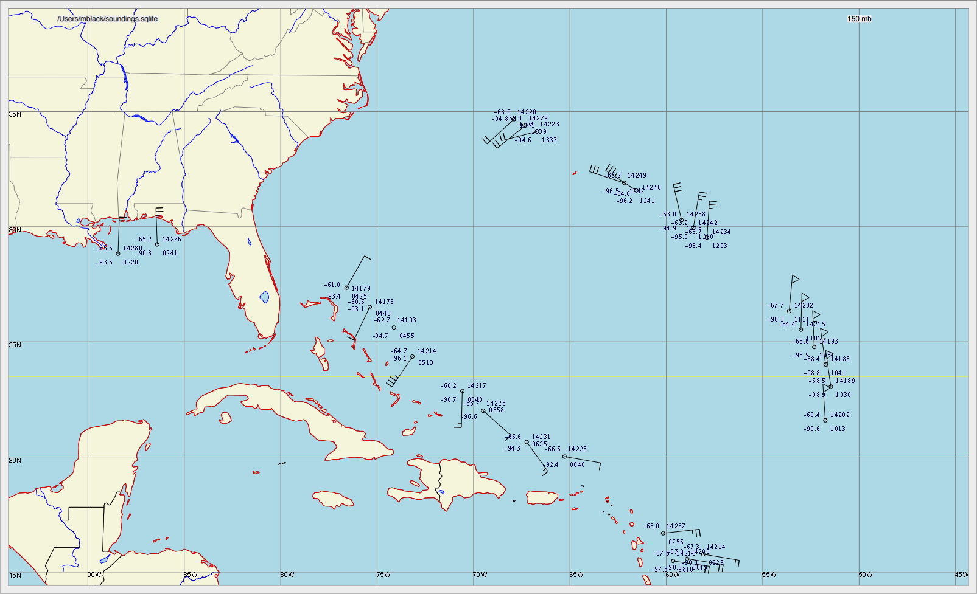
HS3 Observations of Leslie’s Outflow (150 mb)
7 Sept, 2012

Slide 10
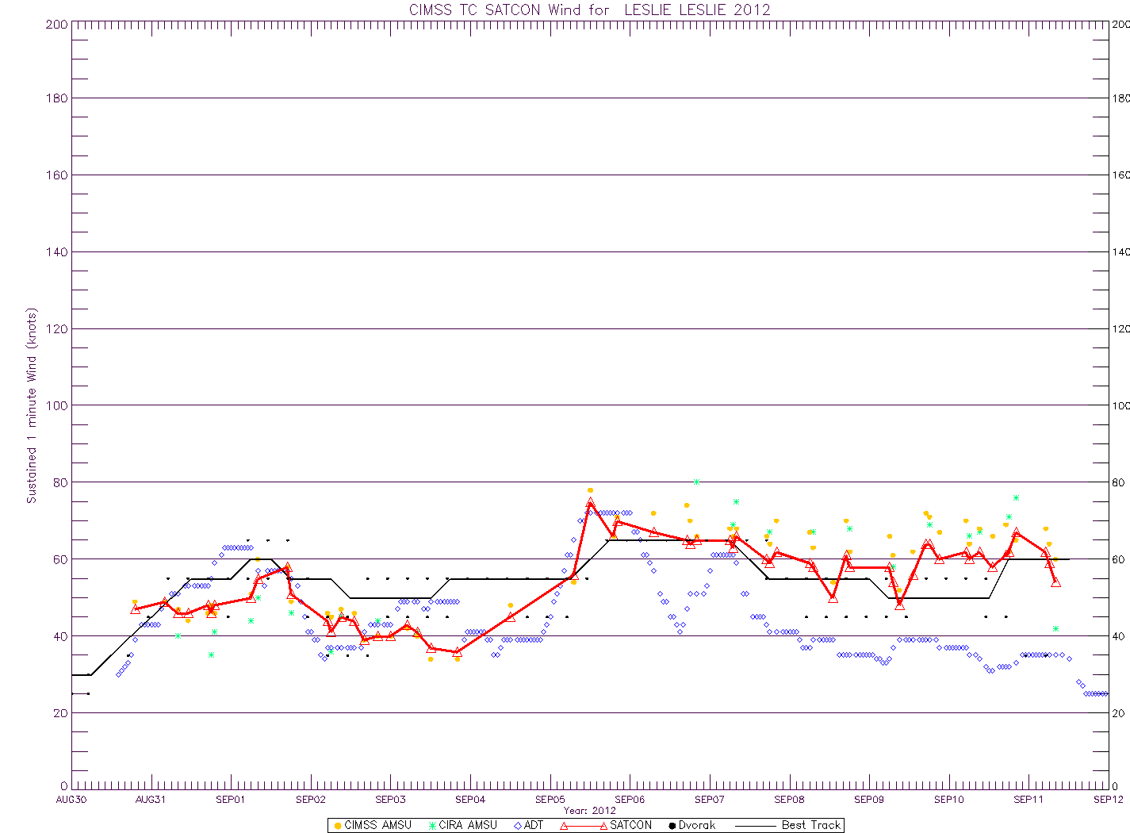
HS3 Observations of Leslie’s Outflow (150 mb)
80
Leslie CAT1
60
Vmax (kt)
40
CIMSS SATCON
20
Leslie
Center
4
5
6
7
8
9
Sept
X
Cross Section
6 sondes
Notes:
This slide shows an example of the capability of the Global Hawk (GH) to observe the upper level outflow jet structure and evolution, as exhibited by these wind observations (depicted as wind barbs where a triangle is 50 kt, a single full line 10 kt and a half line 5 kt) at 150-mb for Leslie. The ellipse shows the sondes used in the following analyses. The inset shows a visible satellite cloud image at the time of the wind observations (1013 – 1111 GMT). The thick white arrow indicates the wind direction in the outflow jet and the thin blue arrow the direction of travel of the GH.

Slide 11
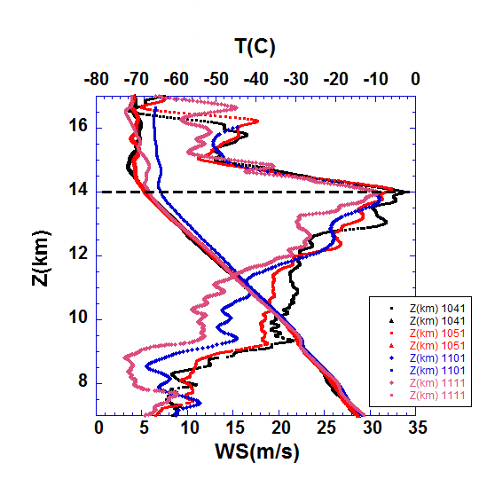
HS3 Observations of Leslie’s Outflow
7 Sep 2012
1041-1111Z
Black, Red, Blue and Pink lines:
Global Hawk observed
wind speed and
temperature profiles
along jet maximum
from dropsondes
Green line: COAMPS-TC model
wind speed profile
Red line: Satellite wind speed
vertical average
Solid black: Tropopause
Dashed: Cirrus top / jet max
Dotted: Cirrus cloud base
Yellow shading: Cloud Physics
Lidar (CPL) domain
Notes:
Four dropsondes along the axis of Leslie’s outflow jet showing similar narrow wind maxima just below the tropopause height, along with layers of nearly constant wind with height just above the tropopause, below the wind max and below the cirrus cloud deck suggesting shear-induced mixing above the wind max and evaporation-driven mixing below the cirrus cloud deck. Change in temperature lapse rate from adiabatic slope to constant temperature vs height indicates tropopause transition to strong stability. The vertical red line indicates the mean value of the CIMSS 100- 250 mb winds along this segment of the outflow jet. The yellow shading indicates the region of the CPL profiles, showing details of the cirrus cloud structure in next slide.

Slide 12
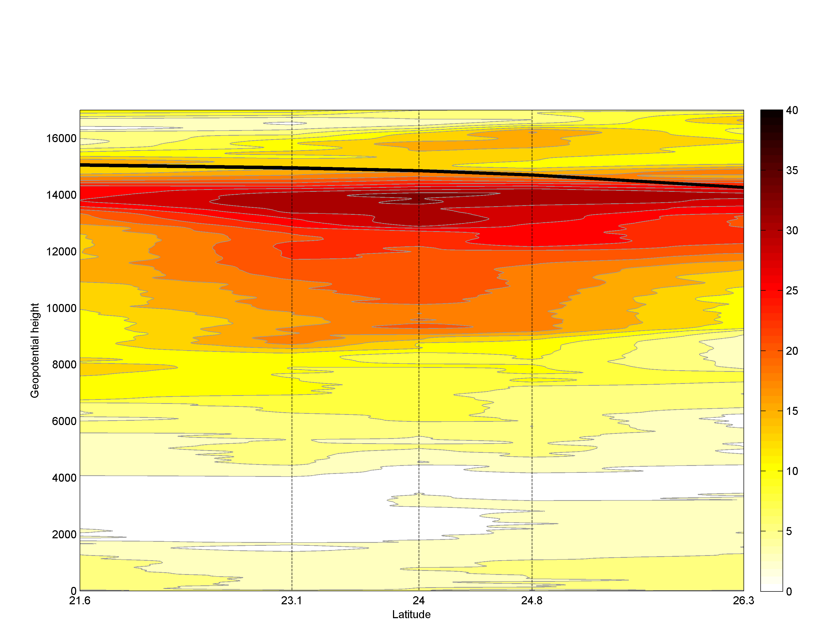
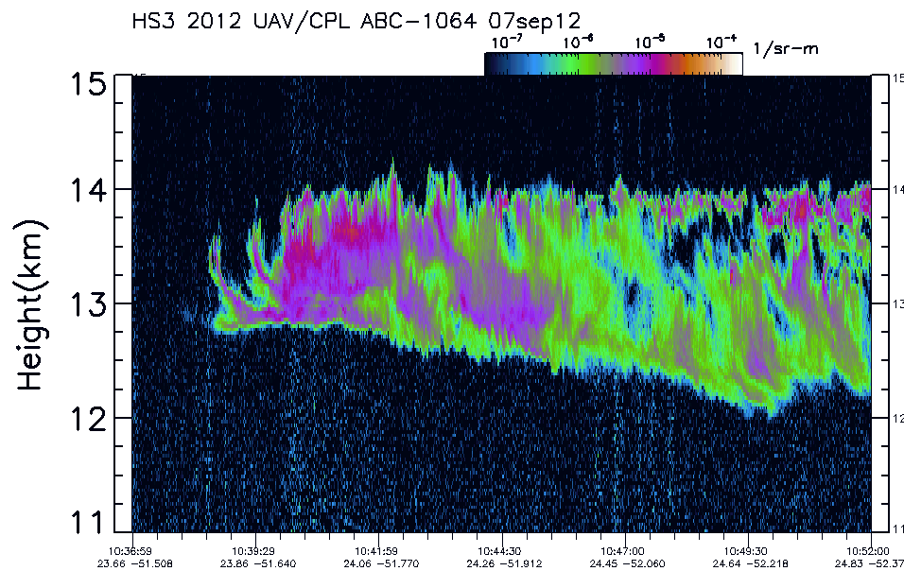
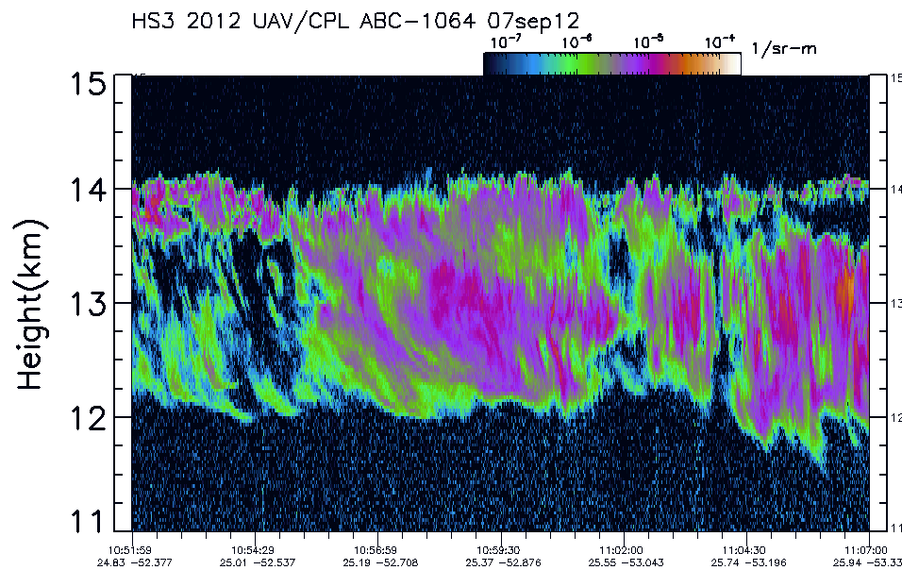
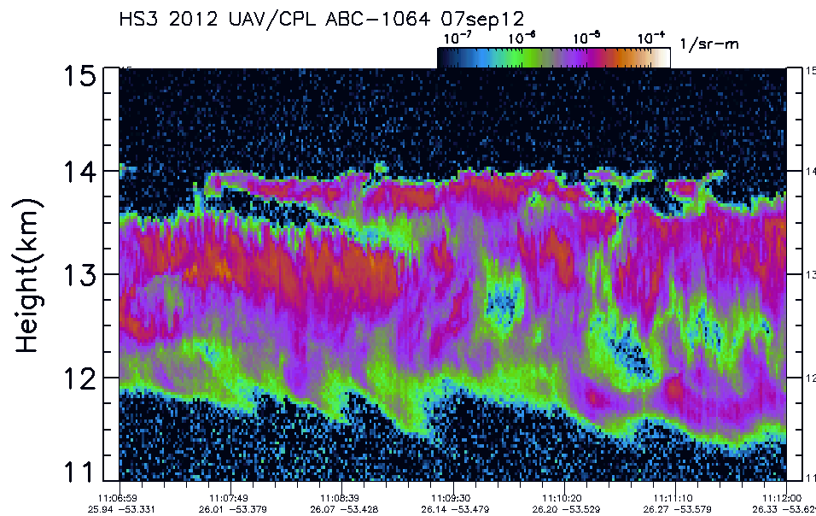
Tropopause
Total Wind Speed
Isotachs every 2.5 m/s
South
North
Cloud Physics
LIDAR (CPL):
Outflow layer
cloud image
HS3 dropsondes reveal unprecedented detail in depiction of outflow jet
Sharp shear zone just above the sloping tropopause (~14 km) and below outflow jet
Top of outflow jet coincident with top of cirrus deck from CPL
Detailed cirrus fine structure suggestive of multiple turbulent mixing mechanisms
Notes:
Vertical section based on 5 dropsondes from Leslie. The cross section highlights a sharp shear zone just above the sloping tropopause and below the jet max with the top of the outflow jet coincident with the top of the cirrus deck as diagnosed from the Cloud Physics Lidar (lower panel) onboard the global hawk (AV-6). The detailed cirrus fine structure is suggestive of multiple turbulent mixing mechanisms.

Slide 13
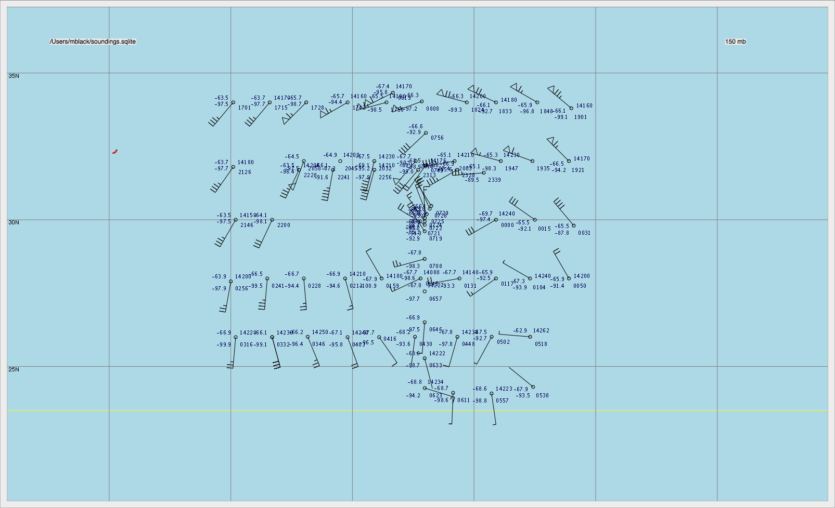
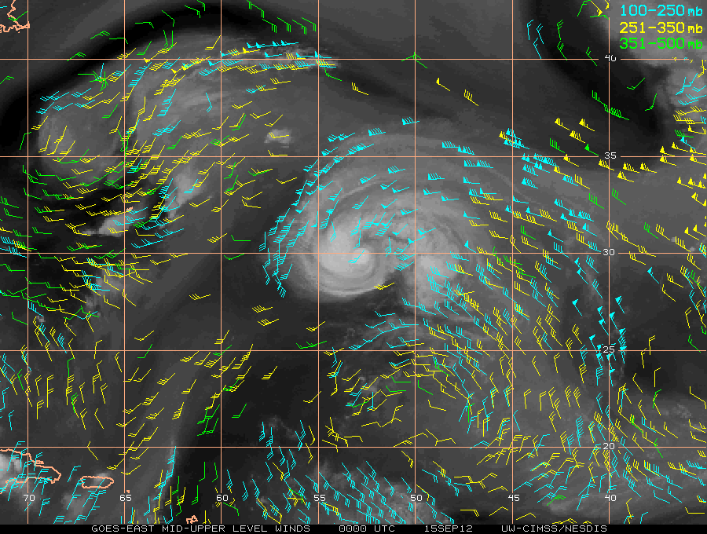

Slide 14
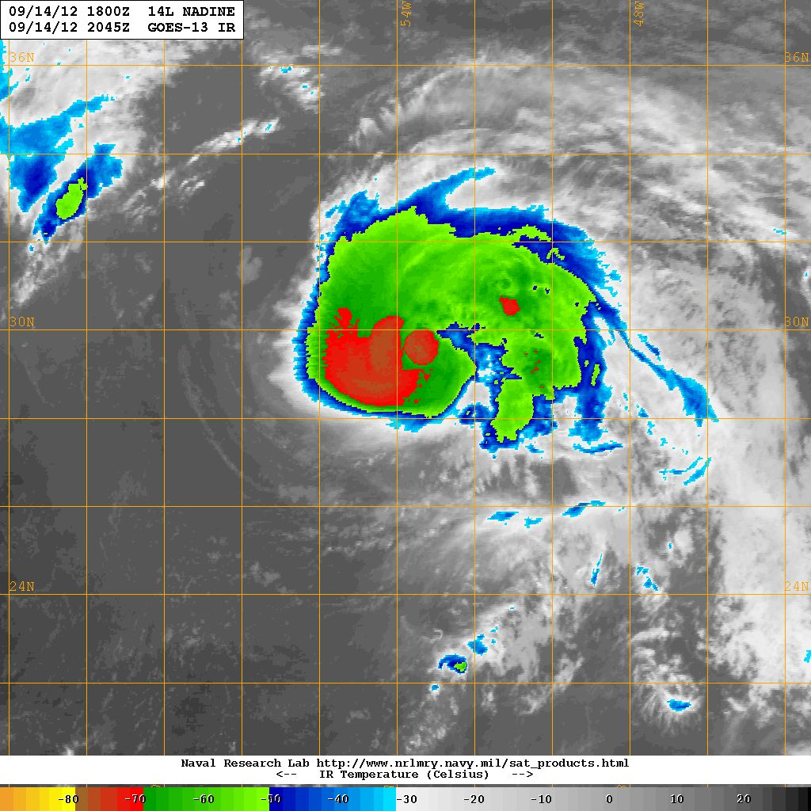
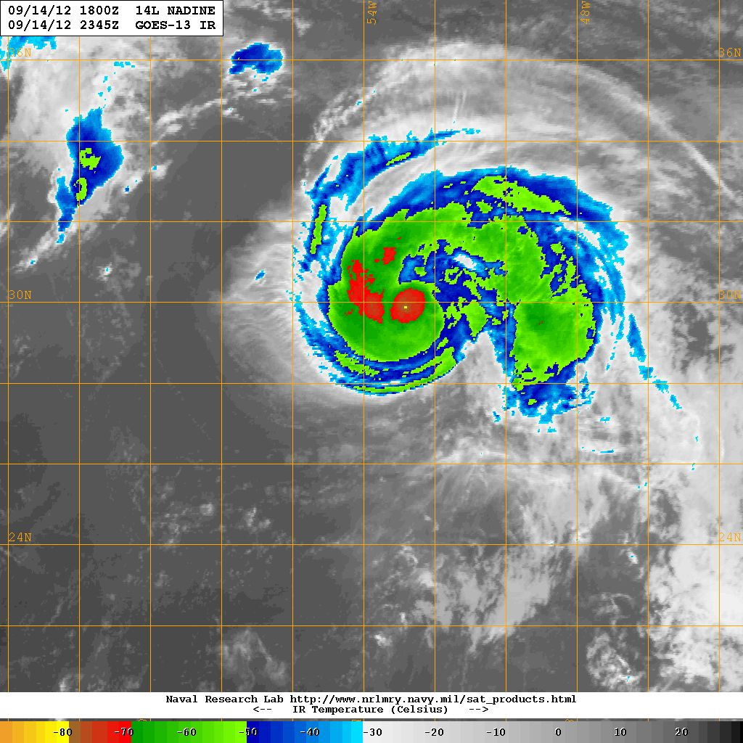
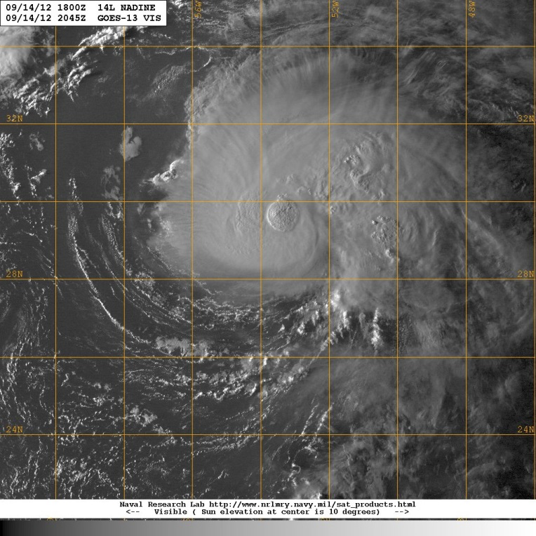
Outflow forced by
SUPERCELL
Convection:
PASSIVE OUTFLOW?
OR:
Supercell forced by
divergent outflow
as a result of
environmental
interaction:
ACTIVE OUTFLOW

Slide 15
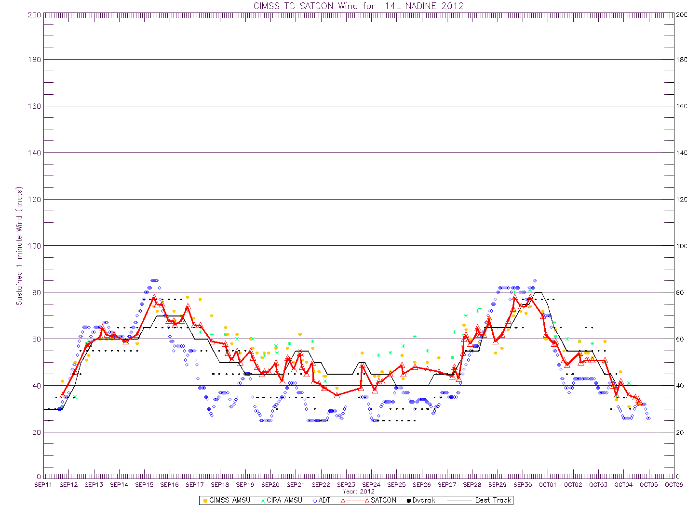
Nadine
CIMSS shear: 0-20 kt
SHIPS/CIRA shear: 0-50 kt
SHIPS/CIRA SST: 20-30 C
RSS MW-OI SST: 20-30 C
30
25
20
15
10
GH AV-6 Flight
5

Slide 16
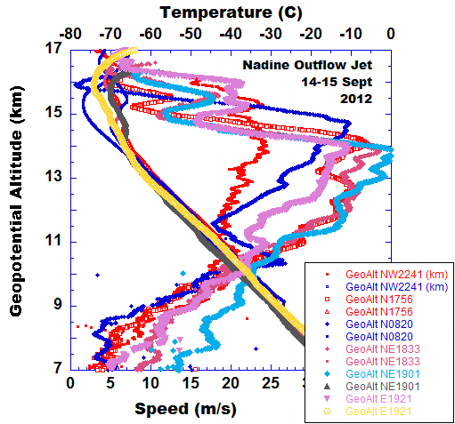
1. Double jet max below
Tropopause (dashed
line)
2. Main jet max decreases
in height, becomes
stronger and thinner with
Increasing radial distance.
3. Structure repeatable in
6 sondes along jet max.

Slide 17
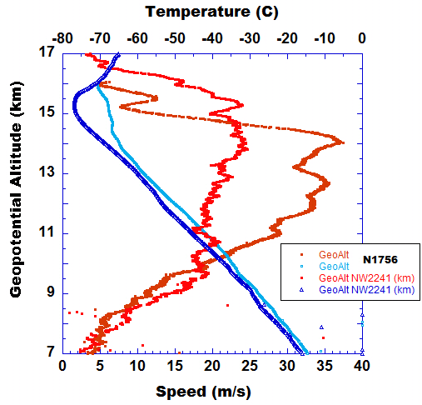
Green is CIMSS mean upper
wind at sonde location.

Slide 18
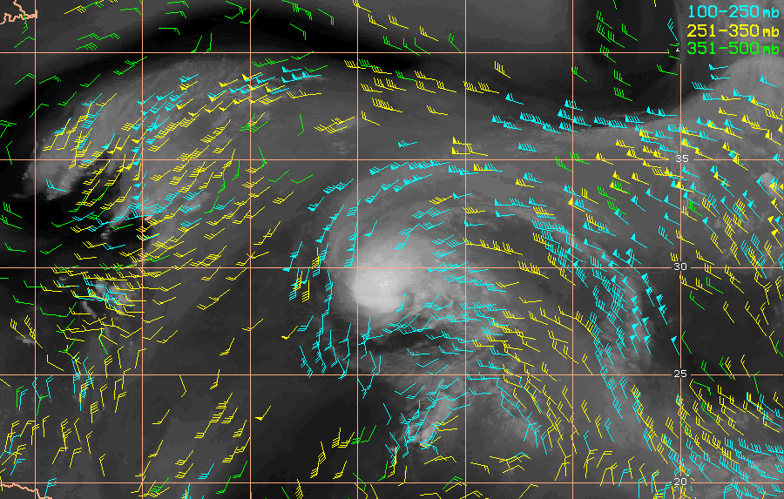
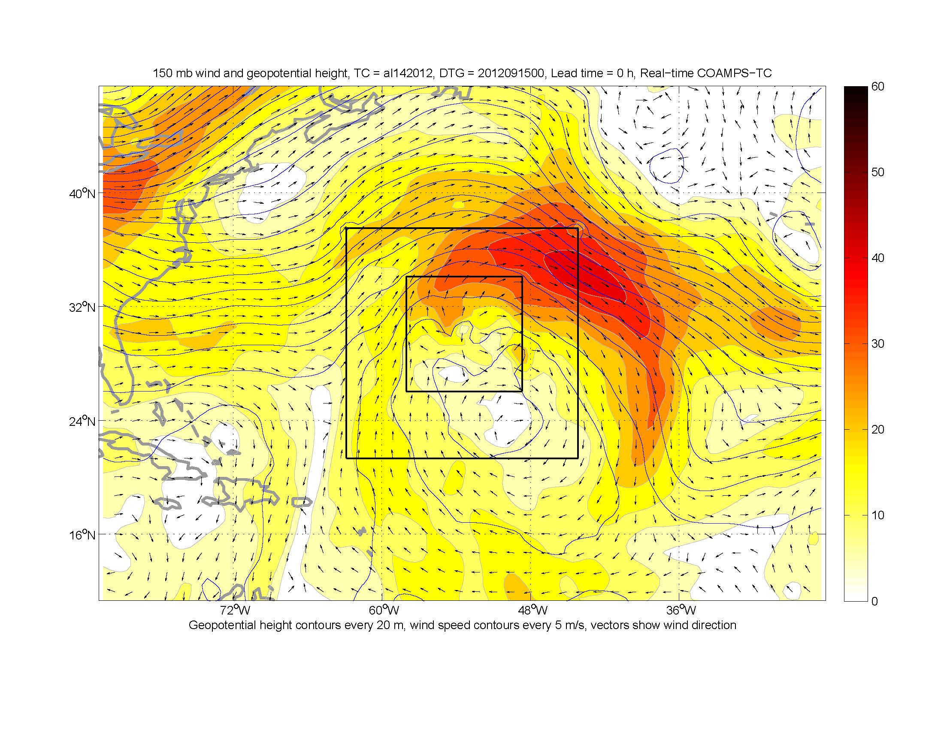
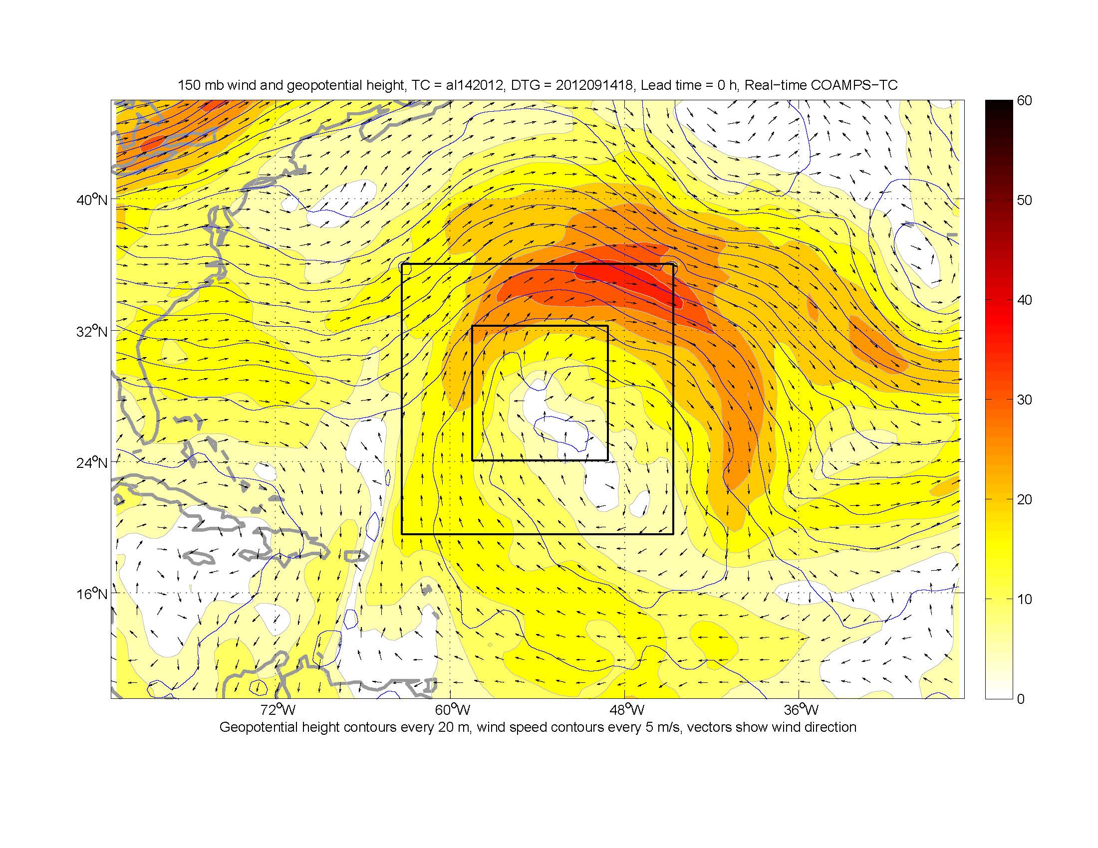
Outflow jet structure forced by by ‘OMEGA’
pattern forced by upwind and downwind
trough development?

Slide 19
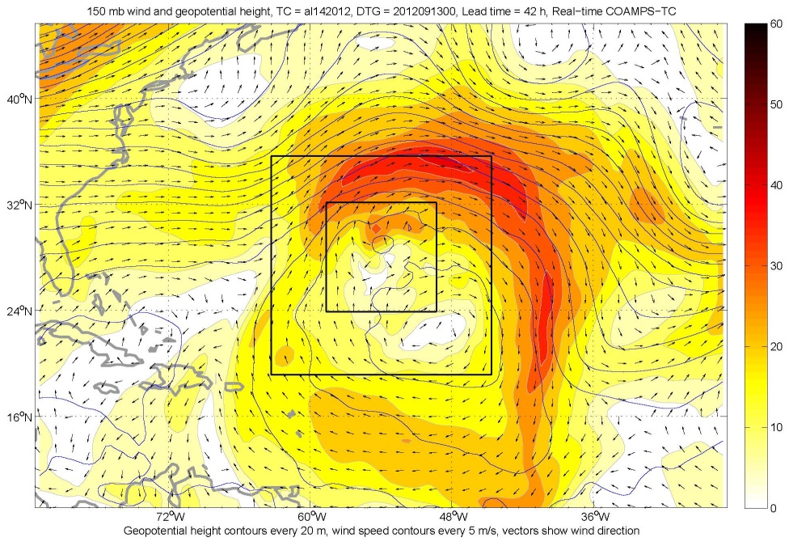
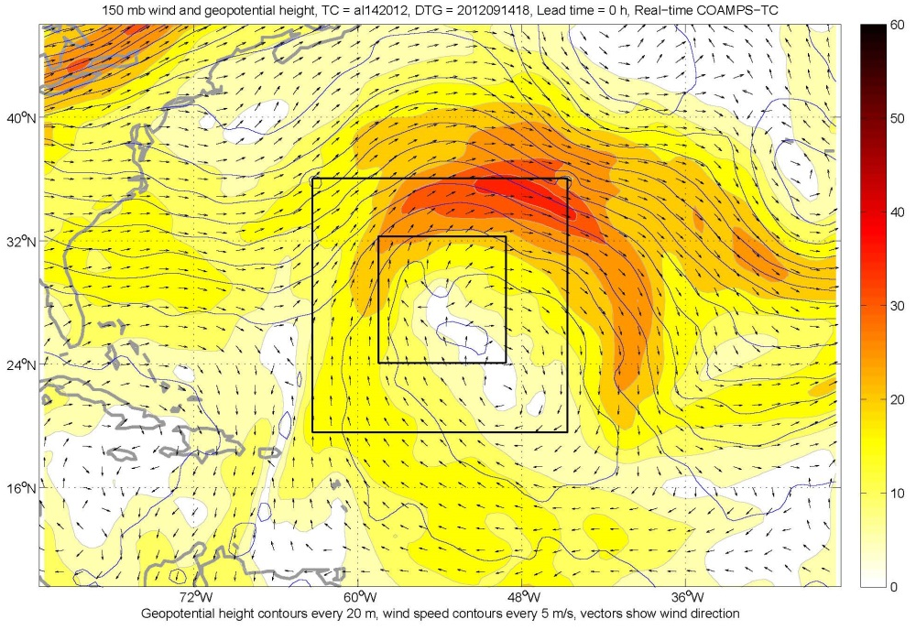
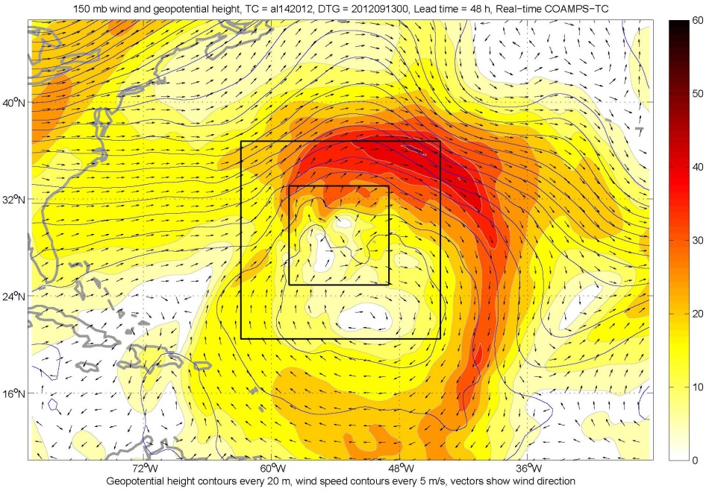
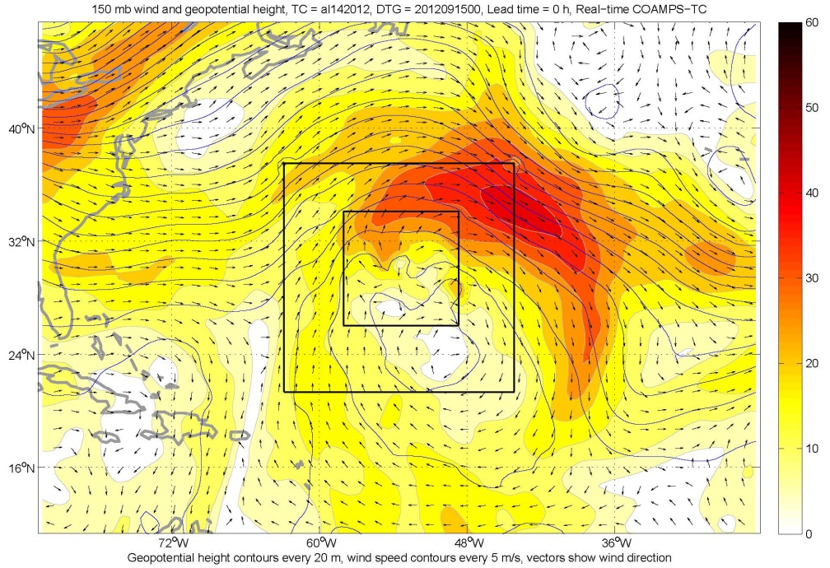

Slide 20
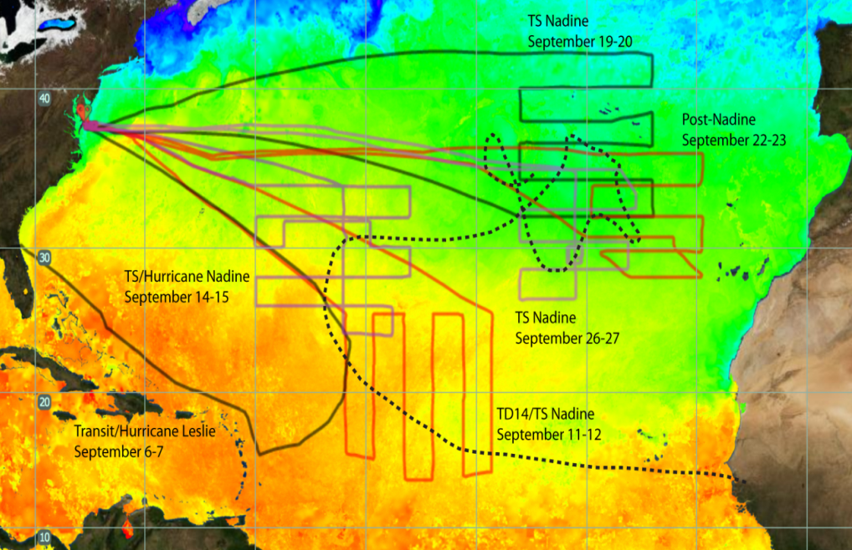
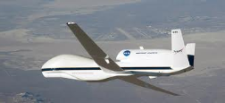
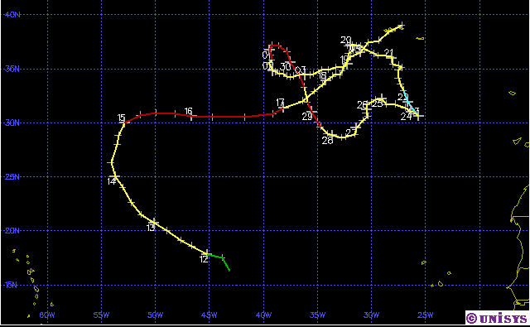
NASA HS3 Observations
of Leslie and Nadine
NASA HS3 Global Hawk Flight Tracks
Nadine: 11 Sep – 04 Oct 2012
76 Drops
80 kts
55 kts
58 Drops
70 kts
50 kts
65 kts
65 kts
70 Drops
75 Drops
35 kts
30 Drops
34 Drops
Nadine was the 5th longest-lived Atlantic hurricane on record.
Nadine intensity varied from a 35 knot tropical storm to 80 knot hurricane.
NASA HS3 Global Hawk deployed over 300 dropsondes during 5 flights in Nadine and 30 dropsondes in Leslie.
Notes:
This slide provides an overview of the HS3 global hawk missions (left) and the best track for Hurricane Nadine (right), in which the global hawk had 5 flights.

Slide 21
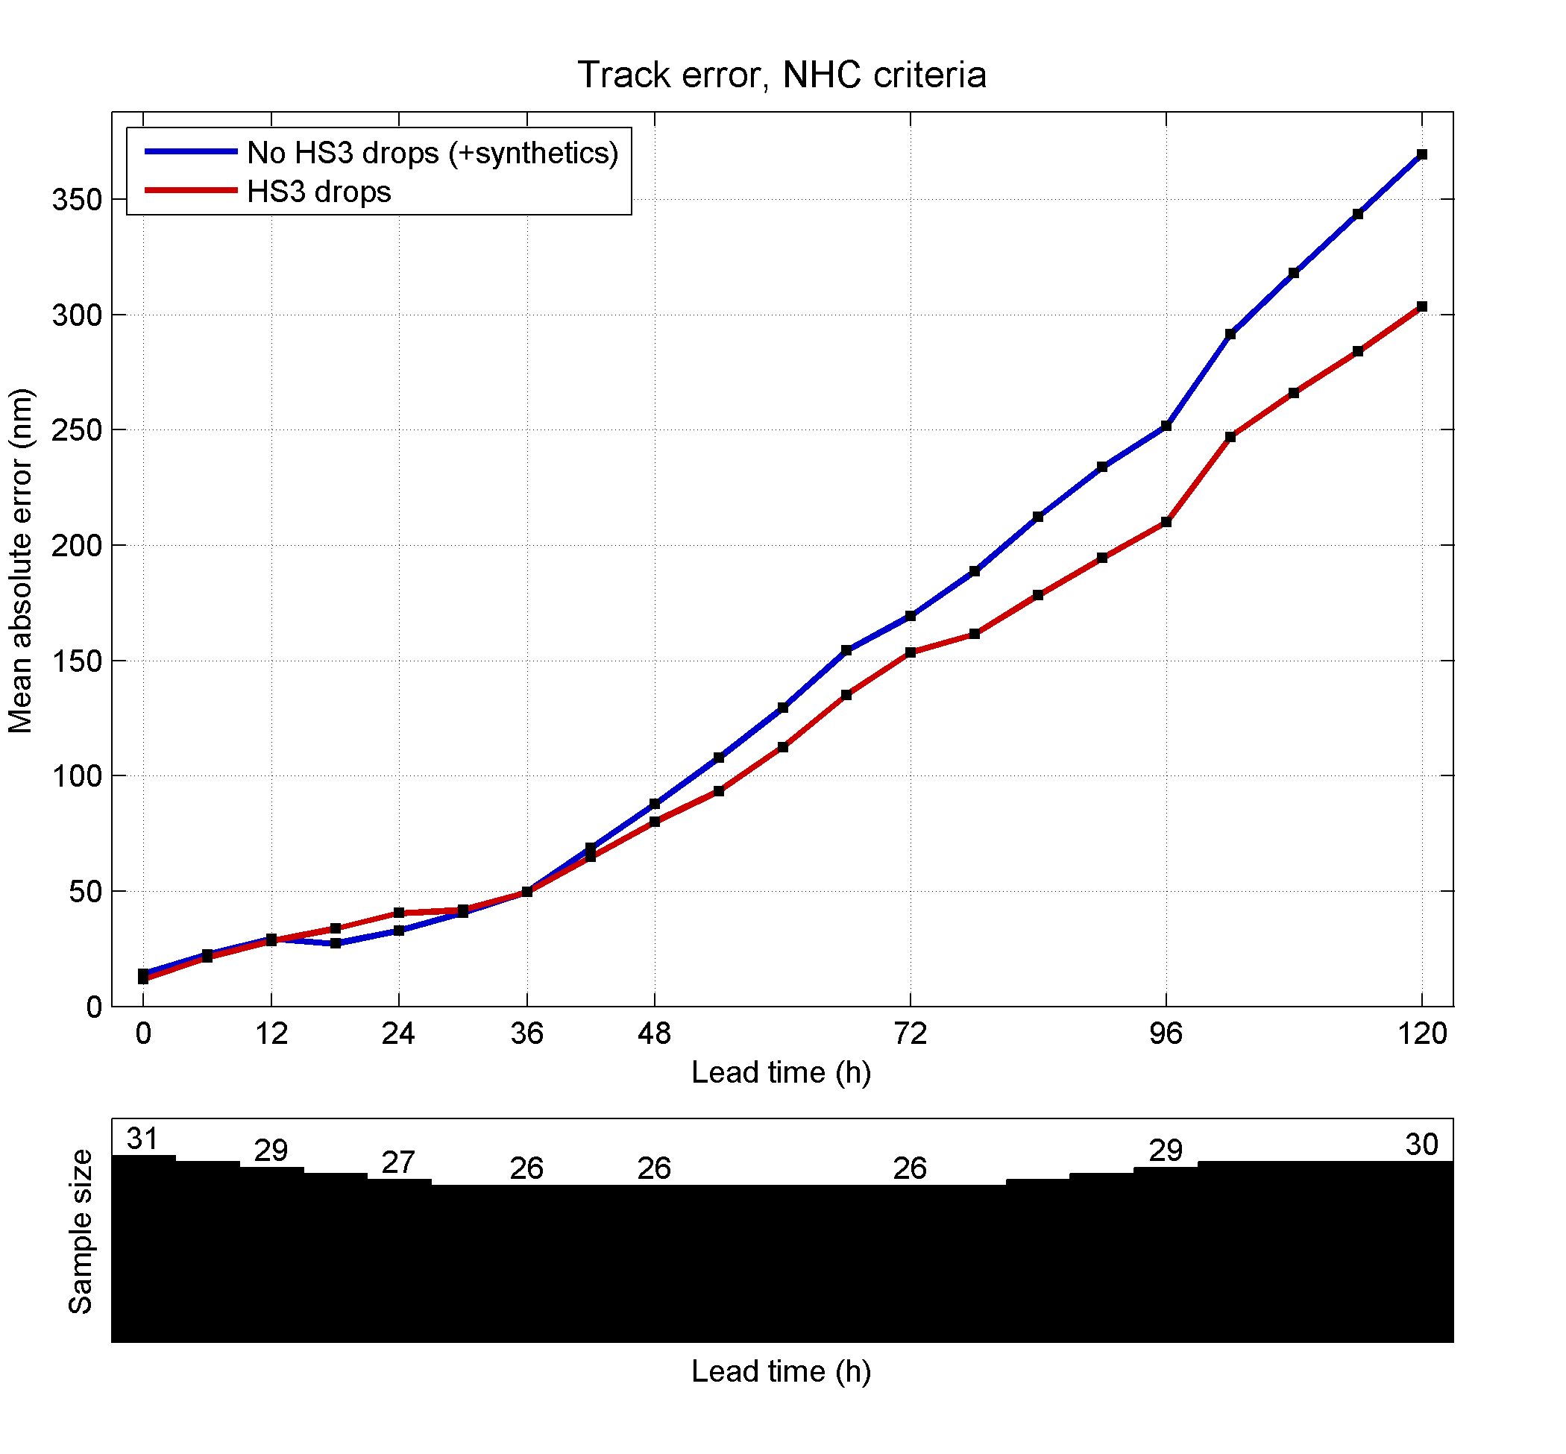
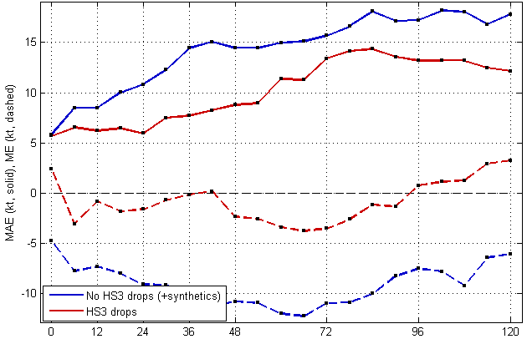
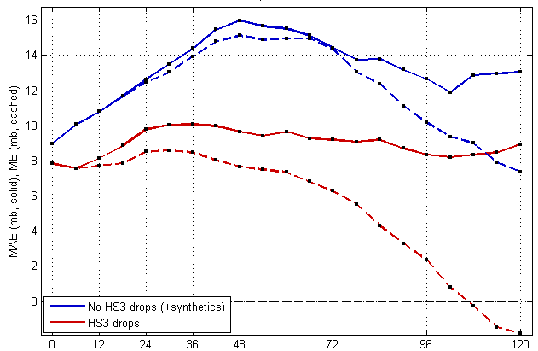
Nadine
No drops
No drops
HS3 drops
Track Error (nm)
HS3 drops
Intensity: Vmax Error (kts)
Bias (dash)
No drops
Dropsonde impact experiments performed for 19-28 Sep. (3 flights)
  Blue, with HS3 drops
  Red, No drops with synthetics
COAMPS-TC Intensity and Track skill are improved greatly through assimilation of HS3 Drops.
HS3 drops
Intensity: Pmin Error (mb)
Bias (dash)

Slide 22
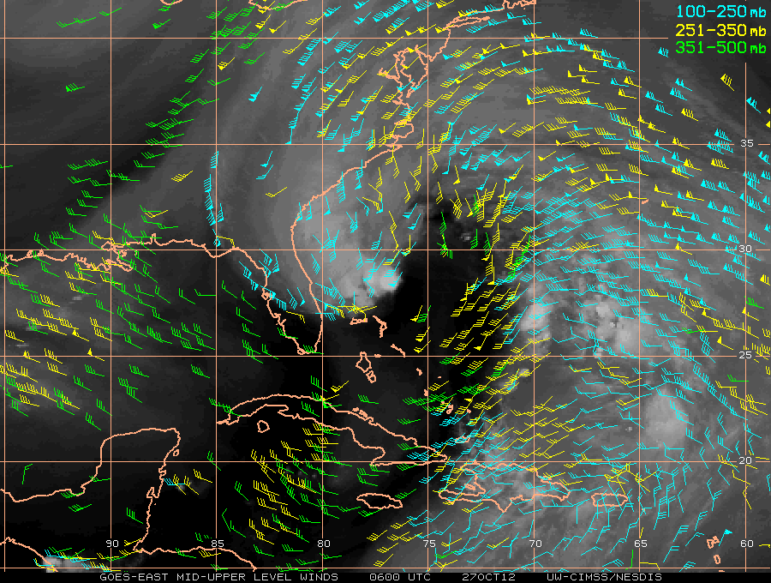
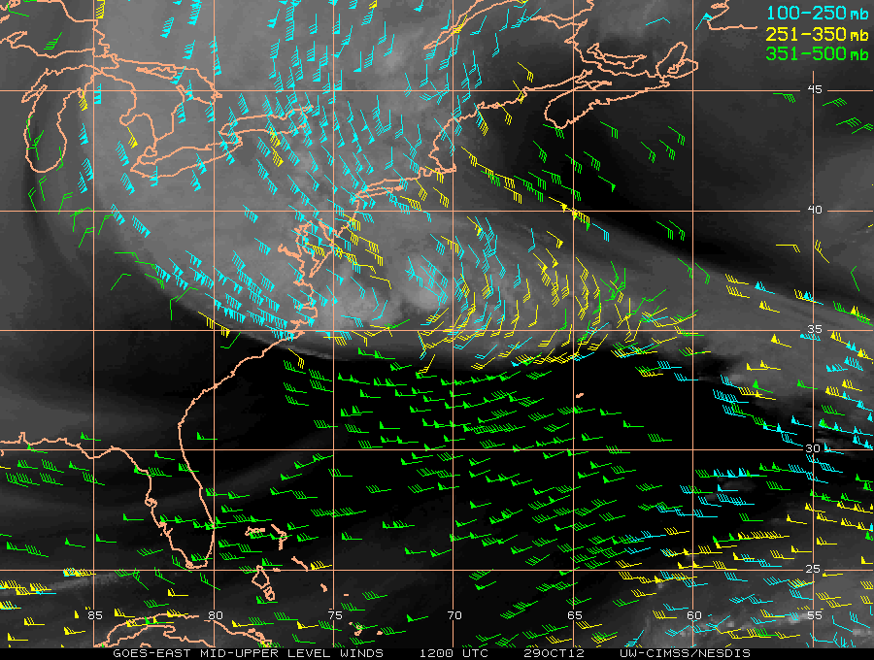
Dramatic Upper-Level Outflow Change during Hurricane Sandy
1) Jet streak associated with upper-level trough (thick blue arrow) approaches Sandy, creating expanded outflow structure (white arrows) toward the north and east. The intensity decreases slightly, but the size of the storm increases dramatically. Strong anticyclonic outflow displaced east of the center (pink dot) supports asymmetric deep convection.
10/27/06z: Sandy intensity = 60 kt
2) Strong outflow displaced west and north, intensifying and expanding (jet max of 100–140 kt), with dramatic change forced by intensifying ridge (blue arrows) northeast of Sandy. Sandy intensifies, further expands and accelerates just prior to landfall.
10/29/12z: Sandy intensity = 80 kt
Notes:
Overview of the impact of upper-level outflow during the evolution of Hurricane Sandy. In stage 1, Sandy rapidly intensifies and crosses Cuba as a category 2 storm. Divergence from an upper-level trough to the west of TC helps support widespread deep convection. Outflow directed north and east. During stage 2, An upper-level trough superimposes on Sandy, giving the storm a ‘hybrid’ structure. The intensity diminishes, but the size of the storm increases drastically. Strong outflow toward the north supports asymmetric deep convection. In the last stage before landfall, stage 3, the outflow jet expands and intensifies dramatically (broad area of 100+ kt). The storm intensifies and expands associated with strong upper-level divergence.

Slide 23
Resulting Hurricane Sandy Landfall Impact
Landfall of larger, more intense storm 12-hours earlier than expected.
Devastating storm surge superimposed on high tide rather than weaker storm surge superimposed on low tide 12-hours later.
Driven by Active Outfow?
Notes:
Consequences of larger, more intense and faster moving storm than forecasted, possibly forced by dramatic change in outflow structure.

Slide 24
Summary
We hypothesize that hurricane outflow is the key to unraveling the complex nature of hurricane intensity and structure.
Hurricane outflow is the only TC component that has not been systematically observed or studied.
Leverage the unprecedented opportunity to deploy two NASA Global Hawks and the Air Force WC-130J to observe hurricane intensity, structure and outflow interaction.
Notes:
One of the last remINING UNEXPLORED ASPECTS OF tc’S

